Slide 1
eTOM and TMN Framework
An overview for Telecom Operations and Network Management

Slide 2
Introduction
eTOM (enhanced Telecom Operations Map) - eTOM is a business process framework used by telecom operators to map out and improve their operational processes, covering customer, service, and resource management.
TMN(Telecommunication Management Network) - TMN is a model developed by ITU-T to standardize network management, ensuring seamless operation, administration, maintenance, and provisioning of telecom networks.

Slide 3
What is eTOM?
A standardized framework designed to help telecom service providers manage and optimize their operations.
Provides a common language and methodology for understanding, designing, and improving business processes.
Focuses on key elements: customer relationships, services, resource management, and supply chain.

Slide 4
eTOM Framework Structure
Operations
Focuses on core telecom operations through the Fulfillment, Assurance, and Billing (FAB) processes:
Fulfillment: Delivering products and services to customers.
Assurance: Ensuring the quality and performance of services.
Billing: Managing payments, invoicing, and revenue collection.
Strategy, Infrastructure, and Product (SIP)
Covers long-term planning and management of network infrastructure, product development, and overall business strategy.

Slide 5
3. Enterprise Management
Encompasses corporate-level functions like financial management, human resources, and regulatory compliance.
4. Market and Product Development
Focuses on identifying customer needs, developing new products, and driving marketing and sales strategies.

Slide 6
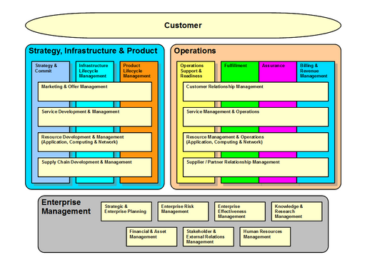

Slide 7
Benefits of eTOM
1.Simplifies Telecom Management
Provides a structured framework for managing complex telecom operations, reducing inefficiencies.
2.Common Language Across Departments
Establishes standardized processes and terminology, improving communication and collaboration within the organization.
3.Enhances Customer Service and Operations Efficiency
Streamlines processes related to service delivery and support, leading to better customer satisfaction and operational performance.

Slide 8
What is TMN?
Telecommunications Management Network is a framework defined by ITU-T for managing telecom networks.
It structures how management data flows between network devices and systems, ensuring efficient network operations and maintenance.
It structures how management data flows between network devices and systems.
Facilitates seamless operation, administration, maintenance, and provisioning (OAM&P) of telecom services, ensuring reliability and service quality.

Slide 9
TMN Layers
Business Management Layer (BML)
Service Management Layer (SML)
Network Management Layer (NML)
Element Management Layer (EML)
Network Element Layer (NEL)

Slide 10
TMN Reference Points
Q Interface
Manages interactions between the network management system and network elements, ensuring smooth data flow for monitoring and control.
F Interface
Facilitates communication between different management systems, allowing coordination across various functional areas.
X Interface
Defines interactions between management systems in different networks, enabling interoperability across telecom operators.

Slide 11
G Interface
Supports communication between network elements within the same layer, ensuring synchronization and smooth internal operations.
M Interface
Connects the user to the management system, allowing human operators to interact with the network management tools.

Slide 12
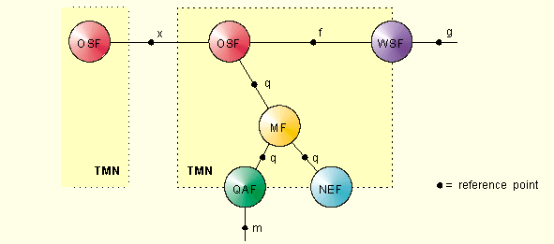

Slide 13
TMN vs eTOM
FOCUS:
eTOM: Primarily focuses on business processes within telecom operations, optimizing customer service, product management, and resource utilization.
TMN: Focuses on the technical management of telecom networks, ensuring efficient network operations, maintenance, and performance.
SCOPE:
eTOM: Covers the entire telecom business lifecycle, including customer interactions, services, and supply chains.
TMN: Deals with the technical aspects of managing network infrastructure, ensuring data flow between systems and devices.

Slide 14
PERCEPTION:
eTOM: Business-oriented, aiming to improve operational efficiency and service delivery.
TMN: Technically-oriented, focusing on network monitoring, administration, and control.
IMPLEMENTATION:
eTOM: Implemented across departments to standardize processes and communication.
TMN: Implemented within network management systems to automate and optimize technical network operations.

Slide 15
Conclusion
Importance of eTOM and TMN
Both eTOM and TMN are essential frameworks for modern telecom management, providing structured approaches to optimize business processes and manage network operations effectively.
They enhance operational efficiency, improve customer service, and ensure reliable network performance, which are crucial in a competitive telecom landscape.

Slide 16
Future Trends in Telecom Management Frameworks
Integration with AI and Automation: Increasing reliance on artificial intelligence and automation to enhance decision-making and streamline operations.
Cloud-Based Solutions: Shift towards cloud-based management systems for scalability, flexibility, and cost-effectiveness.

Slide 17
THANK YOU

